Slide 1
Study abroad as an Archaeology student
October 2022, Cleody van der Eijk
Notes:
https://www.youtube.com/watch?v=cDsgqF6hWLw&list=PLtTBkTm9zeKCDaMk4uXQpjCa2jSKMDbMr
Study Abroad channel - Op shuffle aan!

Slide 2

Topics:
Why go abroad?
Two types of exchange
Requirements
When and Where?
Disclaimer
How to choose?
Applying and deadlines
Financial support
Other options for going abroad
Questions?

Slide 3


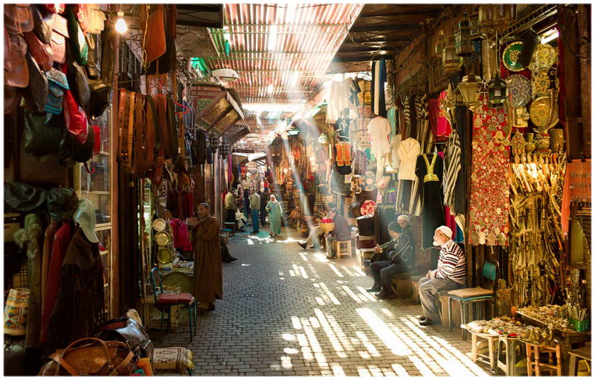

Why go abroad?
Personal development (independence, flexibility, adaptability)
Experience different learning practices
Improve language skills
Work together with people from other cultures
Expand your academic network
Enhance your future employability
Notes:
Please realise that the 21st century skills necessary in todays job market can be shown by an experience studying abroad. It shows you are flexible and that you seek an international environment in which to live and learn.

Slide 4
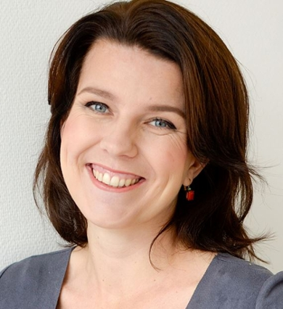
Where to start: faculty vs university-wide
Faculty exchange
  Managed by faculty’s exchange coordinator
  Open to students from faculty/programme only
  Usually for your specific field of study
  Inside Europe (Erasmus+)
  Sometimes outside of Europe
University-wide exchange
  Managed by central International Relations Office (IR) of Student and Educational Affairs (SEA)
  Generally open to all students
  Possible to study outside your field of study at different faculties
  Only outside of Europe
  ISEP programme
Contact:
Faculty Exchange Coordinator
Cleody van der Eijk
exchange@arch.leidenuniv.nl
Contact:
International Relations Office
Student and Educational Affairs
Notes:
As said before, most of our students study abroad through one of our exchange programmes. Option 1.
At Leiden University we have two different kind of exchange agreements:
Faculty- and University wide agreements. [Explain differences]
Faculty agreements
- an agreement might only be open for students who study archaeology or history.
-Inside Europe (referred to as the Erasmus+ programme)
-Outside Europe (some faculties also have agreements outside Europe, usually in a specific field of study).
Contact:
International coordinator of your faculty
University wide agreements
-Managed by central international office (referred to as IR or SEA/SOZ)
-Generally open to all students students from Leiden University: if your faculty participates in the university wide agreement, you are allowed to apply.
-Possible to study outside your field of study at different faculties (als goedgekeurd)
-Only agreements with partner universities outside of Europe

Slide 5

Requirements
GPA 7.0 for all courses at time of application
Language requirements B2 level
  (NB check availability of English courses!)
In general: on track (Propedaeuse obtained)

Slide 6


When and Where?
When?
Archaeology students have
a free semester in the first
semester of BA3
It might be possible to go
during the (R)MA (may cause study delay).
Where?
consider
- Location (Europe or further?)
- Subject/research interest
- Funding possibilities
Via our exchange partners: no extra tuition fee

Slide 7

Erasmus+ Exchange Archaeology
Belgium: Université Libre Bruxelles
Belgium: Univeristy of Gent
Cyprus: University of Cyprus
Denmark: Aarhus Universitet
Germany: University of Bonn
Germany: Universitat Tübingen
Ireland: University College Dublin
Italy: University of Foggia
Italy: La Sapienza University
Italy: University of Siena
Norway: Trondheim University
Portugal: University of Evora
Switzerland: Zürich University
United Kingdom: Durham University
United Kingdom: Edinburgh University
United Kingdom: Newcastle University
United Kingdom: University College London
United Kingdom: York University
http://vignette2.wikia.nocookie.net/harrypotter/images/4/47/Hogwarts-dh2.jpg/revision/latest?cb=20110421152732

Slide 8
Study Abroad and corona (disclaimer)
Studying abroad can be a valuable experience for both your studies and future career. At the festival you can
find out about all the opportunities available. However, be aware that these opportunities are currently
dependent on how the coronavirus situation develops. Therefore, please keep the following in mind:
• Look into the opportunities but always draw up two plans: a study-abroad plan and a staying-at-home
plan. That way you will always have a realistic plan B ready in case you are unable to go abroad.
• Leiden University follows the travel advice issued by the Dutch Ministry of Foreign Affairs: study-related
activities may only take place in areas that are classified as code green or code yellow.
• Travelling and studying abroad is always at your own risk. Therefore, try to postpone incurring costs
for studying abroad until shortly before departure.
• Do you have further questions after having attended or watched the online sessions during the Study
Abroad Festival? Contact your faculty or study programme’s international exchange coordinator.
Notes:
Travel advice can change just before traveling, so keep in mind that plans might have to change very last minute.

Slide 9
How to choose a university?

Slide 10
Courses abroad – how to choose?
Make a list of at least 3 to 5 universities. How?
Check Faculty partner list
Choose one or two countries.
Check availability of courses in English, min. 30 EC per semester, no overlap with content courses of Leiden University and check the entry requirements
Check the general semester and exam dates of the host universities (e.g. in Germany the first semester generally ends in March!)
Do you have special needs? Limited budget? Ask for additional scholarships
Read the student reports of other students

Slide 11
Course requirements
Bachelor:
• Minimum 5 EC should be level 300 or higher
• Have a clear motivation why it is relevant for your programme
(Research)Master:
• All courses should be at master level
• Relevant for your programme
Request for permission from the Board of Examiners
❑ General plan before application
❑ Detailed plan after selection, when host university’s courses are online

Slide 12
Applying and deadlines

Slide 13


How to apply for Faculty Erasmus+ exchange
          Prepare the following documents:
          Motivation letter in English
          Transcript of records including GPA and EC (contact onderwijs@arch.leidenuniv.nl)
          Signed approval from your coordinator of studies
          X At this stage, other than for University-Wide exchange, you do not yet need approval from the board of examiners.
          Upload these documents online, and select 3 - 5 universities.
          Prepare (at least mentally) for a Plan B.
          Application deadline:
          15 February 2023, 23:59
          for a study abroad period (fall semester) in academic year 2023-2024.
Notes:
This is the deadline for the fall semester.

Slide 14
How to apply for Uni-Wide exchange
✓ Find your exchange programme via the Study Abroad website
✓ Check all requirements (GPA, language, course requirements)
✓ Examine the course catalogues and select your courses (NB: check level
requirements!)
✓ Discuss your plan with your study advisor well in time: October/ November
Application deadline:
1 December 2022 23:59
for Study Abroad 2023-2024

Slide 15
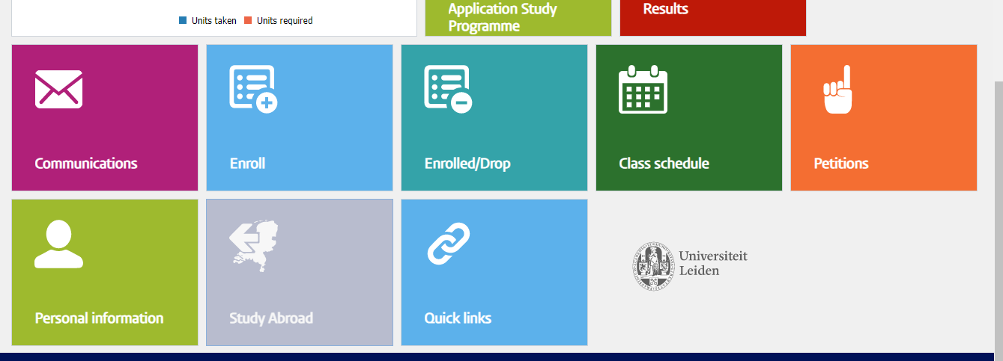
All prepared? Start your online application in Usis

Slide 16

Ireland, by Joëlle Dekker (2016-17 Study Abroad Photo Contest)

Slide 17
Next steps: selection and nomination
You will receive an answer within three weeks after the application deadline.
Accept the offer you receive from your exchange coordinator + upload it in the system
Choose your courses at the selected university according to requirements*
Get approval of the Board of Examiners for your courses + send a copy to exchange coordinator
Wait until you are nominated by exchange coordinator for exchange at your host institution

Slide 18

*Course requirements
(Research)MA: master level + relevant for your programme
BA: minimum of 5 EC courses at level 300 or higher (check host uni entry requirements) + clear motivation for relevance

Slide 19

Other preparations
Arrange housing (check out options via host university)
Prepare a budget plan, check out the ‘Financial Matters’ page: https://www.student.universiteitleiden.nl/en/study--studying/studying-abroad/financial-matters
Arrange your Erasmus+ scholarship or Lustra+ if you go to the UK.
Find out about social activities and try to get in touch with international students before arrival

Slide 20
Financial support

Slide 21
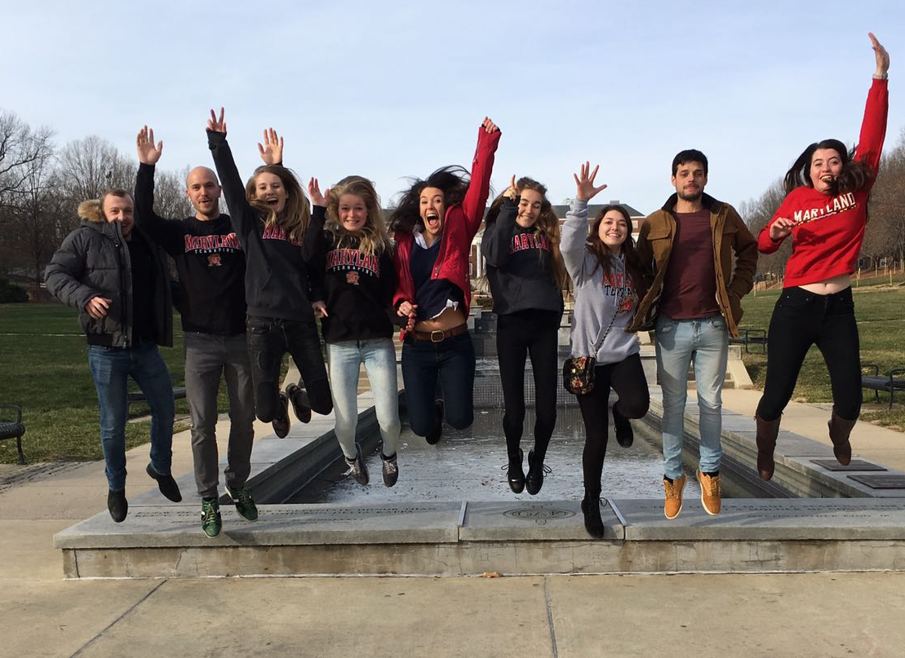
Financial Aid: options
Erasmus+ grant
Leiden University Fund OV allowance (for Dutch students only)
LUSTRA+ grant
Holland Scholarship
LUF/ LISF
Advantage of an official exchange (like Erasmus)
  No extra tuition fees.
  Funding is easier.

Slide 22

Erasmus+ study grant for Faculty exchange
After you have been selected for a spot, apply for an Erasmus+ grant:
www.student.universiteitleiden.nl/en/scholarships/sea/erasmus-for-studies
Note that your grant is not sufficient to cover all (extra) costs.
In 2022 the monthly allowance ranged from
€240 to €360 per month, depending on the
host country.

Slide 23
Important dates
December 1st Deadline proposal for Board of Examiners (UniWide,
prediscussed with study adviser)
December 1st Deadline application UniWide exchange
February 15th Deadline application Erasmus+ exchange (Faculty Exchange)
March-April Apply at exchange university (confer w. exchange coordinator)
Apply for funding
Archaeology Kick-Off meeting – date to be determined
April 1st 2022 deadline Holland Scholarship (excellent students)
Mai/June Apply for Erasmus+ scholarship
Submit your Learning Agreement

Slide 24

Health and Safety
It is very important that you go abroad well prepared!
You are obliged, for example, to take out a good insurance, get the necessary vaccinations and bring along enough money.
These and other very useful tips are mentioned on the Health and Safety pages of the Studying Abroad website
Attend a Health and Safety information session in Leiden or The Hague before departure. Register through the website.
Notes:
Graag Health&Safety website laten zien (zie link hierboven)
https://www.student.universiteitleiden.nl/en/study--studying/studying-abroad/youre-going-what-to-arrange-now/health-and-safety/humanities/international-studies-ba?cf=archaeology&cd=archaeology-ba#tab-1

Slide 25
Other options for going abroad

Slide 26
Other options
Going abroad independently (‘free movers’)
• Choose a safe destination
• You will have to pay double tuition fees, and arrange your own application
• Discuss your plans with your study advisor & study abroad coordinator + ask approval of the board of examiners.
Summer/ Winter schools
• Check the Study Abroad website for an overview and how to arrange (https://www.student.universiteitleiden.nl/en/summer-winter-schools?cf=archaeology&cd=archaeology-ba)
Internship, research and fieldwork
In Brightspace you can find information about internships and fieldwork

Slide 27
Entire master’s abroad
Not possible on exchange agreement
→ You apply directly at the host university
→ You pay tuition fees to host university
→ Limited assistance from international office
→ Start early! At least 1 year in advance → Scholarships
→ Arrange diploma recognition by DUO after you return

Slide 28
Links
Website Leiden University: student.universiteitleiden.nl/en/study--studying/studying-abroad
Find exchange agreements: leidenuniv.nl/soz/buitenland/search-exchange-agreements.html
Website Nuffic (organisation for internationalisation in education): wilweg.nl
Scholarship websites:
• Leiden University –https://www.universiteitleiden.nl/en/scholarships
• Nuffic - wilweg.nl/financiering/beursopener
• StudyPortals - scholarshipportal.com
Studying/living costs per country: vsbfonds.nl/kosten-en-ervaringen-studeren-buitenland

Slide 29
Questions?
Your faculty exchange coordinator:
Cleody van der Eijk exchange@arch.leidenuniv.nl
Your university-wide coordinators:
Sanne Feenstra: +31 (0) 71 527 3063Ivo Bles: +31 (0) 71 527 1785 studyabroad@sea.leidenuniv.nl
Open consultation hours:
Monday 14:00-17:00 (Plexus, Leiden)
Wednesday 10:00-13:00 (Wijnhaven, The Hague)
Notes:
Nog aanpassen

Slide 30
Thank you!

